Slide 1
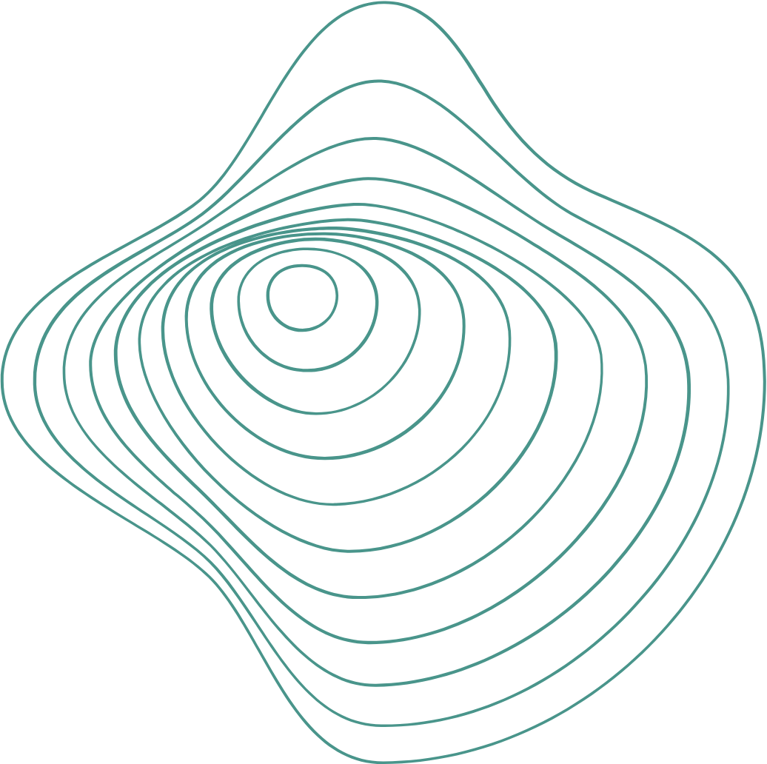

Vignan’s Institute of Management and Technology for Women
Department of AI and ML
BRIDGING THE GAP BETWEEN HUMANS AND MACHINES
Neuralink
Merging the Human Brain with Technology
Name:Desala Likhitha Mahalaxmi
Roll No: 20UP1A6611

Slide 2
Abstract
Neuralink, a pioneering neurotechnology company founded by Elon Musk, is at the forefront of the emerging field of brain-computer interfaces.
Their groundbreaking work centers around the development of neural implants and sophisticated signal processing algorithms, aiming to create a seamless connection between the human brain and artificial intelligence systems.
With the potential to restore sensory functions, augment cognitive abilities, and transform communication for individuals with disabilities, Neuralink's technology holds promise in revolutionizing human-computer interaction.
However, the path forward is rife with challenges, including navigating regulatory frameworks, ensuring long-term implant safety, and addressing the ethical implications of merging human minds with machines.
As we stand on the brink of this neurotechnological revolution, it is crucial to explore both the possibilities and the complex questions that Neuralink and similar endeavors raise for society, ethics, and science.

Slide 3
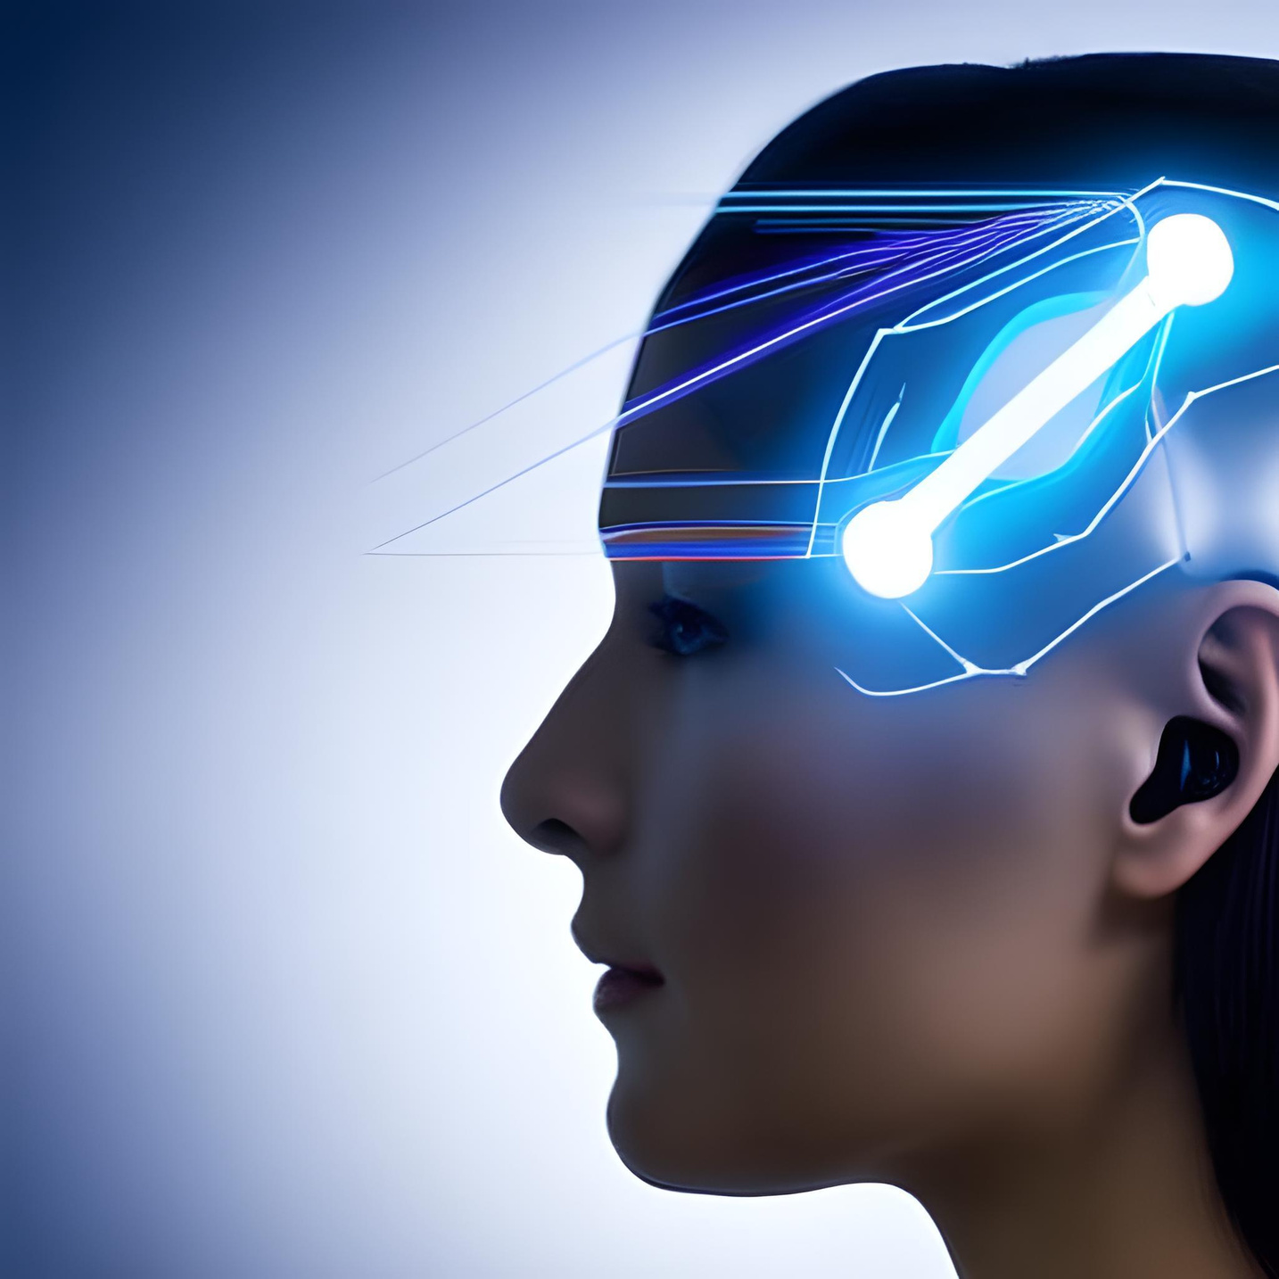
Agenda
Introduction to Neuralink
History and Background
The Science Behind Neuralink
Neuralink's Vision and Mission
Benefits and Applications
Ethical Considerations
Challenges and Concerns
Current Progress and Achievements
Conclusion
Q&A
References

Slide 4
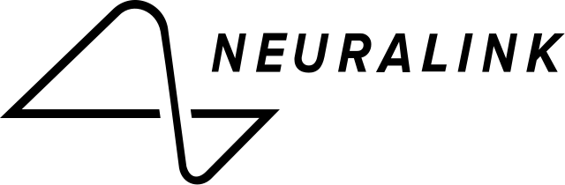
Introduction:
In the quest to unlock the mysteries of the human mind and merge it with the power of technology, Neuralink stands as a beacon of innovation, with Elon Musk's visionary leadership propelling us into uncharted territories.
Neuralink is a neurotechnology company founded by Elon Musk in 2016.
The company's primary mission is to develop advanced brain-machine interfaces (BMIs) that can establish a direct and high-bandwidth connection between the human brain and computers or artificial intelligence systems.
These interfaces aim to facilitate seamless communication between the brain and external devices, potentially enabling a wide range of applications, from medical treatments to cognitive enhancements.

Slide 5




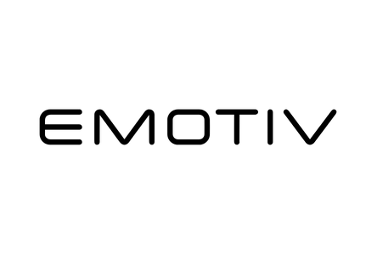
The Importance of Brain-Computer Interfaces
BCI stands for Brain-Computer Interface, which is a technology that allows direct communication between the brain and external devices or computer systems. BCIs can be used for various purposes, including medical applications like helping individuals with paralysis regain control over their limbs or enabling people with certain disabilities to communicate and control their environment.
Some BCI companies are Neuralink BrainGate Kernal Ctrl-labs (now part of Meta Platforms, Inc.) Emotiv

Slide 6

Why Neuralink is Important?
Exploring the Future of Brain-Computer Interfaces
Advanced Research: Neuralink is conducting cutting-edge research in neural interfaces, including the development of implantable devices that aim to achieve high-resolution communication with the brain.
Funding: Neuralink has secured significant financial resources, which can accelerate research and development efforts.
Leadership: Elon Musk's involvement and vision for the future have generated substantial interest and media coverage, contributing to the perception that Neuralink is a leader in the field.
Transparency: Neuralink has been relatively open about its progress and goals, providing updates on its research and developments.

Slide 7
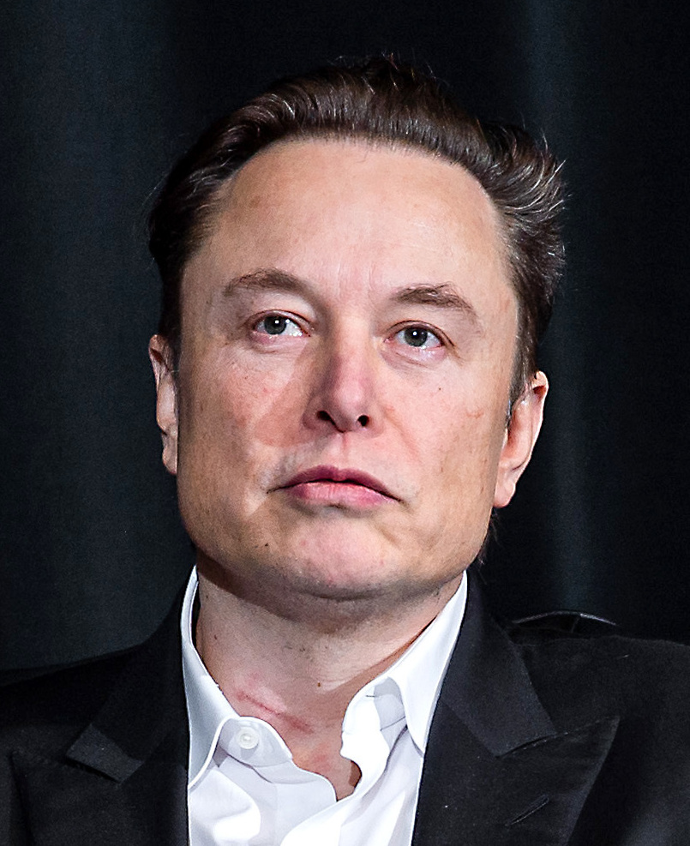
Elon Musk's Involvement:
Elon Musk, renowned for his ventures in SpaceX and Tesla, has been a driving force behind Neuralink. He co-founded the company with the goal of accelerating the development of BMIs and expanding human capabilities. Musk's involvement not only brings significant financial resources but also his visionary approach to technology, which has helped to garner attention and investment in the field of neurotechnology.

Slide 8

History
and Background
Founding and Early Years
Initial Funding and Progress
Public Demonstrations
Progress and Ambitious Goals
Regulatory Approvals and Clinical Trials
2016 - 2017
2017 - 2019
2019-2020
2020-2021
Current
Elon Musk co-founded Neuralink with a team of scientists and engineers, including Max Hodak and several others.
In 2017, they raised $27 million, and in 2019, they secured an additional $158 million in a funding round led by Elon Musk.
They demonstrated a prototype of their BCI system.They also showed a pig named Gertrude that had a Neuralink implant.
Potential to treat various neurological conditions, such as Parkinson's disease and depression.
They received approval from the U.S. Food and Drug Administration (FDA) to implant the Neuralink device in a limited number of human participants

Slide 9
Neuroscience | This involves studying the structure and function of the brain's neurons and how they communicate with each other through electrical and chemical signals.
Electrode Technology | They have been working on creating ultra-thin, flexible electrodes that can be implanted into the brain with minimal damage to brain tissue.
Brain-Machine Interface (BMI) | This involves interpreting neural signals to control external devices and providing sensory feedback to the brain from those devices.
Data Analysis and Machine Learning | Machine learning and data analysis techniques are used to decode neural signals and enable the user to control external devices or receive sensory input.
The Science behind Neuralink
The Future of Brain-Computer Interfaces
Where science meets the mind's potential, forging connections between biology and technology to unlock the limitless possibilities of the human brain.

Slide 10
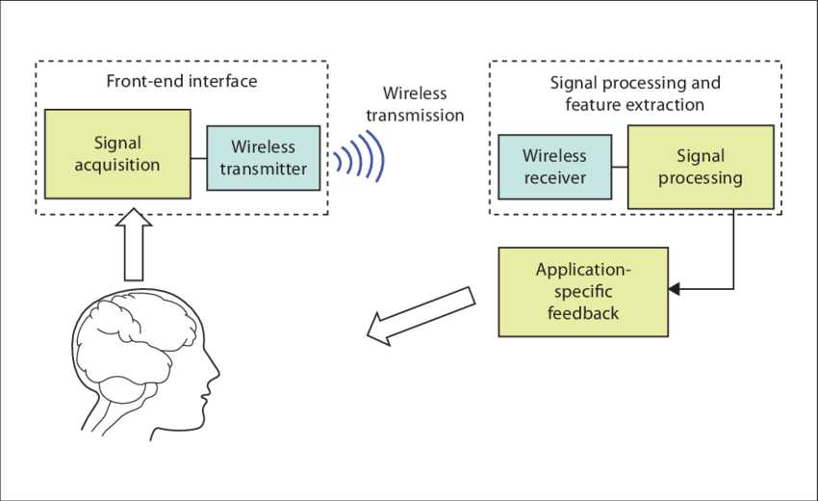

How Does it work?
Brain Implantation
Neural Signal Recording
Data Acquisition and Amplification
Analog-to-Digital Conversion
Data Transmission
Signal Processing and Analysis
Output to External Device
Feedback to the Brain (Future Goals)

Slide 11
Machine Learning | Various machine learning algorithms, including Support Vector Machines (SVM), Random Forest, and Neural Networks, are employed to classify brain signals into different states or actions.
Deep Learning | Convolutional Neural Networks (CNNs) and Recurrent Neural Networks (RNNs) have been applied for feature learning and classification tasks in BCI.
Generative algorithms | Generative models commonly used in BCI include variational Autoencoder (VAE),Generative Adversarial Networks (GANs), etc.
Algorithms Used
Various algorithms and techniques are used in BCI research and applications to interpret and process brain signals. Here are some of the key algorithms and methods commonly used in BCI:

Slide 12
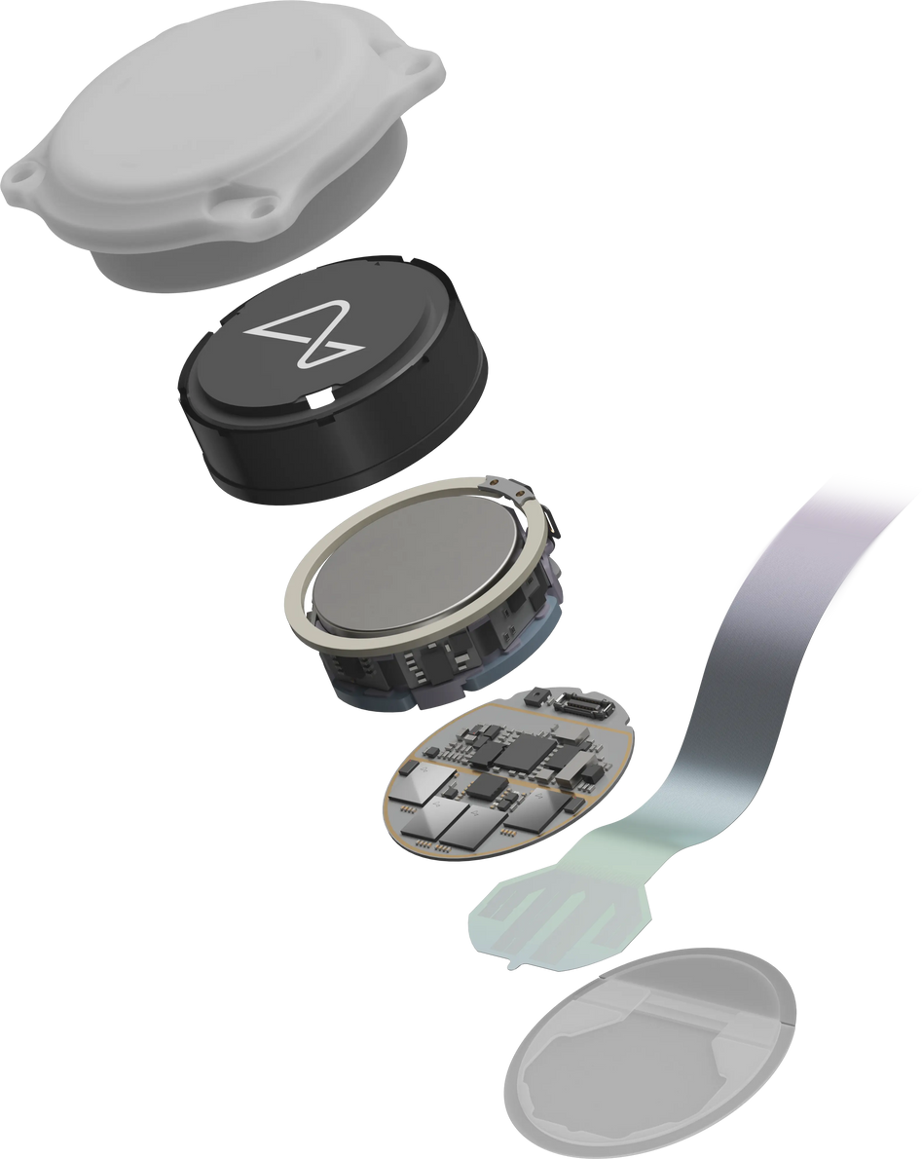
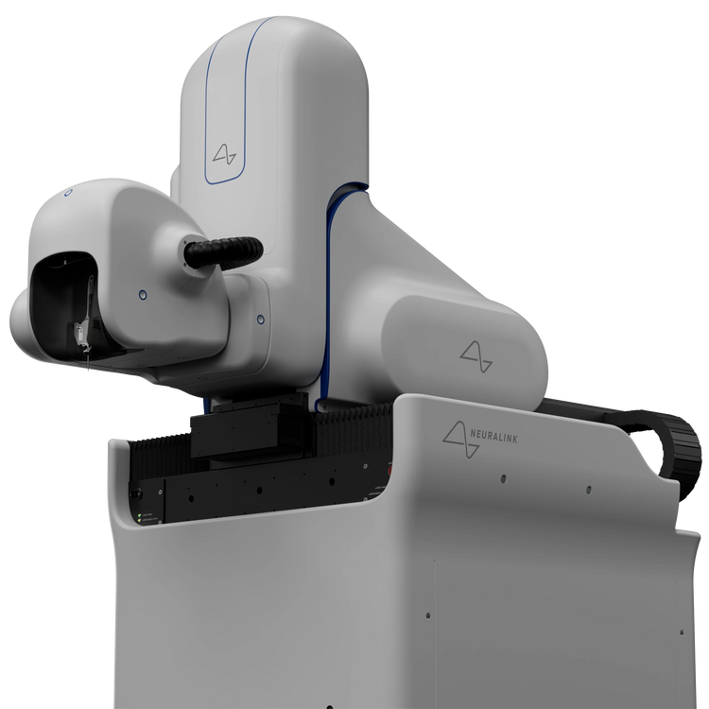
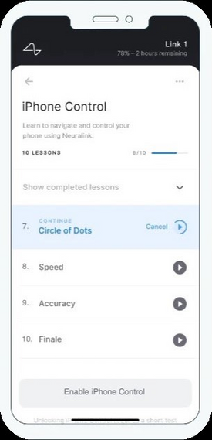
The N1 Implant records neural activity through 1024 electrodes distributed across 64 threads.
It’s Components
Implant
Surgical robot
Neuralink App
Implant | Biocompatible Enclosure Battery Chips and Electronics Threads
Surgical Robot | Base Structure Robot Head Needle
Neuralink App | reliable computer control and prioritizes ease of use.

Slide 13
Neuralink’s Vision and Mission
Vision | Mission
Neuralink's vision is to create a seamless interface between the human brain and computer technology. They aim to develop cutting-edge brain-machine interfaces (BMIs) that can bridge the gap between the human brain and external devices, enabling direct communication and interaction between the two. This vision encompasses a wide range of potential applications, from medical treatments for neurological disorders to enhancing human capabilities through brain augmentation. | Advancing Neuroscience Medical Applications( Paralysis, epilepsy, and depression) Cognitive Enhancement: (Memory enhancement or faster information processing) Ethical Considerations: (Privacy, security, and consent) Long-Term Vision: A symbiotic relationship between humans and AI.

Slide 14
Benefits and Applications
While still in its early stages, Neuralink holds the potential to unlock a new era of human capability and understanding, from treating neurological disorders to enhancing communication, cognition, and control, all while pushing the boundaries of science and technology.
Medical Treatments | Control of External Devices | Others
Neurological Disorders Memory Enhancement Speech Restoration Augmented Communication Mental Health | Prosthetic Control Computer Control Assistive Technology | Entertainment and Gaming Research and Exploration Neuroscience and Brain Research

Slide 15

Ethical Considerations
Neuralink's promise demands ethical vigilance.
Informed Consent
Privacy and Data Security
Equity and Accessibility
Cognitive Enhancement
Safety and Long-term Effects
Autonomy and Identity
Unintended Consequences
Regulatory Oversight
Ethical Guidelines for Research
Ethical Frameworks

Slide 16

Challenges and Concerns
Exploring the mind's potential through technology is a journey that must navigate the terrain of possibility while treading carefully on the ethical tightrope.
Surgical Procedure
Long-Term Safety
Data Privacy and Security
Ethical Concerns
Regulatory Approval
Integration with Existing Technology

Slide 17
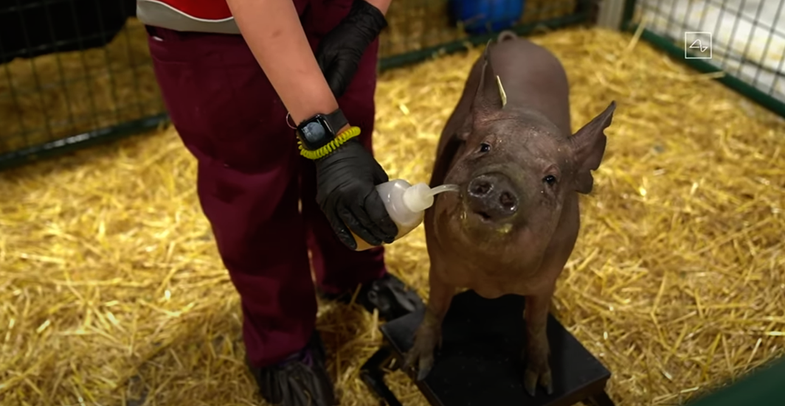
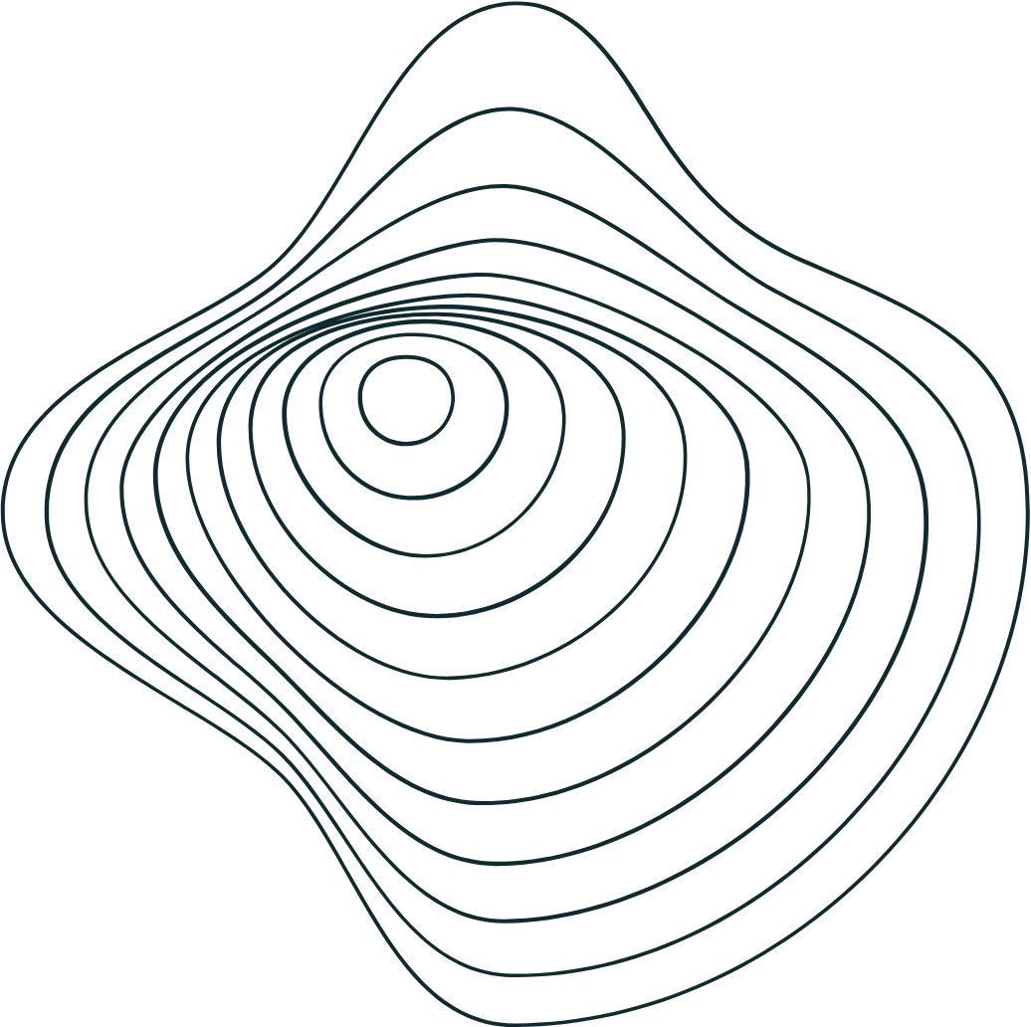
Current Progress and Achievements
Demonstrations of Brain Control
Neuralink showcased demonstrations where pigs were implanted with their technology, and they demonstrated the ability to read and interpret neural signals related to the pig's movements and sensations. Elon Musk, the founder of Neuralink, also presented a pig with a working Neuralink implant during a live webcast
Three Pigs: Neuralink introduced three pigs named Gertrude, Dorothy, and Joyce. Each pig had a different level of involvement in the experiment.
Gertrude was the primary pig used to demonstrate the functionality of the Neuralink brain implant. Dorothy had previously received a Neuralink implant, but it was later removed. Joyce, the third pig, was not implanted with a Neuralink device. Instead, she served as a control or reference pig

Slide 18

Conclusion
Neuralink, founded by Elon Musk, endeavors to merge the human brain with technology through brain-machine interfaces (BMIs). While promising groundbreaking advancements, such as restoring mobility for individuals with disabilities and enhancing cognition, Neuralink faces ethical, regulatory, and technical challenges. These challenges range from ensuring informed consent and protecting neural data privacy to navigating complex regulatory landscapes. The long-term success and societal impact of Neuralink's technology remain uncertain, hinging on its ability to overcome these obstacles. Neuralink symbolizes the potential for remarkable progress in neurotechnology but underscores the importance of responsible development and ethical considerations in its pursuit.

Slide 19

Do you have
any questions?
Q and A

Slide 20
References
https://neuralink.com/
https://www.bbc.com/news/health-65717487
E. Musk, "Neuralink: An Integrated Brain-Machine Interface Platform With Thousands of Channels", J Med Internet Res, vol. 21, no. 10, Oct 2019. https://www.jmir.org/2019/10/e16194/
Sarah Marsh, "Neurotechnology: Elon Musk and the goal of human enhancement", The Guardian, January 2018.
https://www.ncbi.nlm.nih.gov/pmc/articles/PMC6914248/ https://www.nytimes.com/2022/11/30/health/elon-musk-neuralink-brain-device.html https://www.thehindu.com/sci-tech/science/neuralink-elon-musk-fda-concerns-human-clinical-trials/article66915151.ece

Slide 21

“Thank You!”
Likhitha.

